Slide 1

School of Engineering Civil Engineering Department
Ph.D
M.Tech.
Sp. in Structural Engineering
Sp. in Transportation Engineering
B.Tech.
Sp. in Construction Technology Management
Diploma.

Slide 2
Glimpse
of
Department of Civil Engineering

Slide 3
-------------WHY TO JOIN ------------- CIVIL ENGINEERING
It is the second oldest branch of engineering after Military Engineering. It is a professional and core engineering that offers design, estimates, constructions plan and renovation for physical built works.
1. Work in an Exciting Environment
Civil Engineers play a key role in the whole process, from designing a project, to bringing it to life and maintaining it. Study this subject and you will be part of its quick-moving and challenging nature.
2. Learn Valuable Transferable Skills
Students learn skills that can be employed to numerous other professions. These include problem-solving, decision-making, analytical and IT. In addition to knowledge of science, maths and technology.

Slide 4
-------------WHY ------------- CIVIL ENGINEERING
Countless Job & Research Opportunity
Government Jobs e.g. UPSE, Pollution Board, Irrigation, Sewerage Treatment Plant (STP/ETP), Public Works (Road and Building Construction), Municipal Corporations, Airports Authority of India (AAI), Indian Railways, Thermal Power Plants, Indian, Army, Indian Navy
Public Sector Unit (PSUs): SAIL, IRCON, RITES, NBCC, RVNL, DMRC, NHPC, NTPC are few to mention.
Private Sector: Real Estate, Highway Construction, Cement Plant, Railways Construction and many more
Research Organization: ISRO, DRDO, CSIR, Civil Aviation Research Organization (CARO), Central Soil Salinity Research Institute, Indian Institute of Soil Science, (IISS) etc., IITs, NITs, Research Labs ………..
Entrepreneur: Builder, Contractor (Govt. & Pvt.), Testing Lab, Designing & Construction Consultant etc.

Slide 5
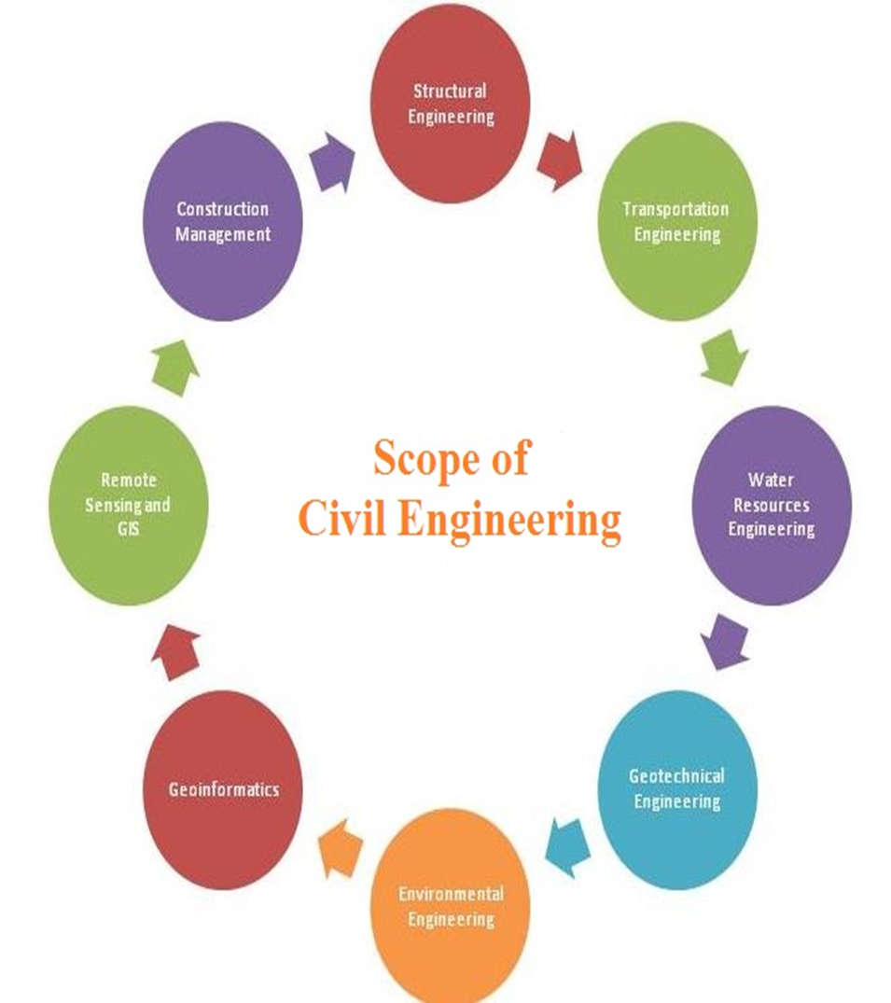
Major Specialization of Civil Engineering

Slide 6
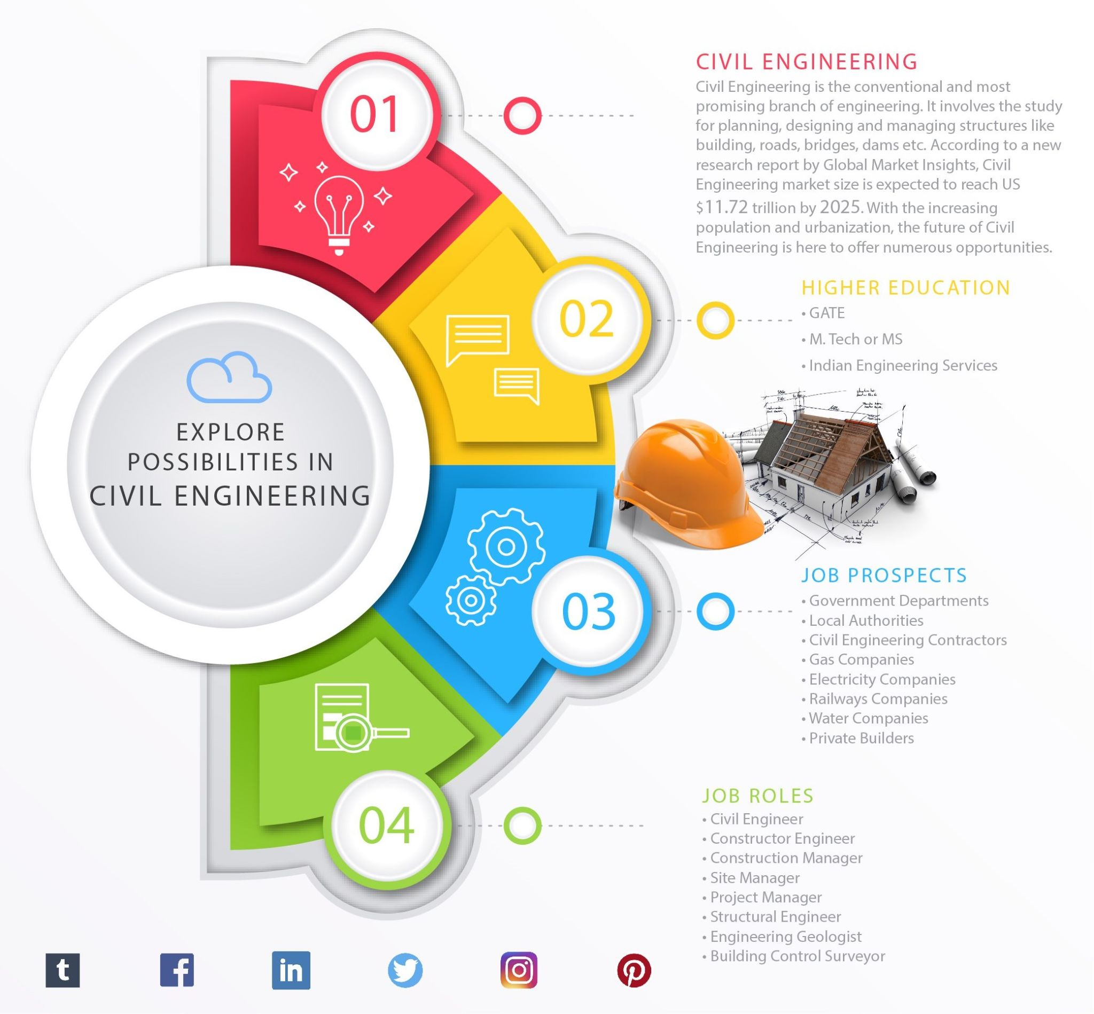

Slide 7
USPs
Industry relevant courses in cutting edge technology of Civil Engineering.
Research oriented academic program with modern laboratories with latest equipment.
Active participation of Industries in teaching-learning process through industry visits & guest speakers from IITs
Enhancement of Engineering skills through competitions in technical events
Focus on Lab Assignments, Research & Industry Ready projects
Students Participation in Co-curricular and Extra-curricular activities
Develop linguistic & analytical skills, creative & communication skills by Soft skill training
Advanced reasoning and aptitude classes

Slide 8
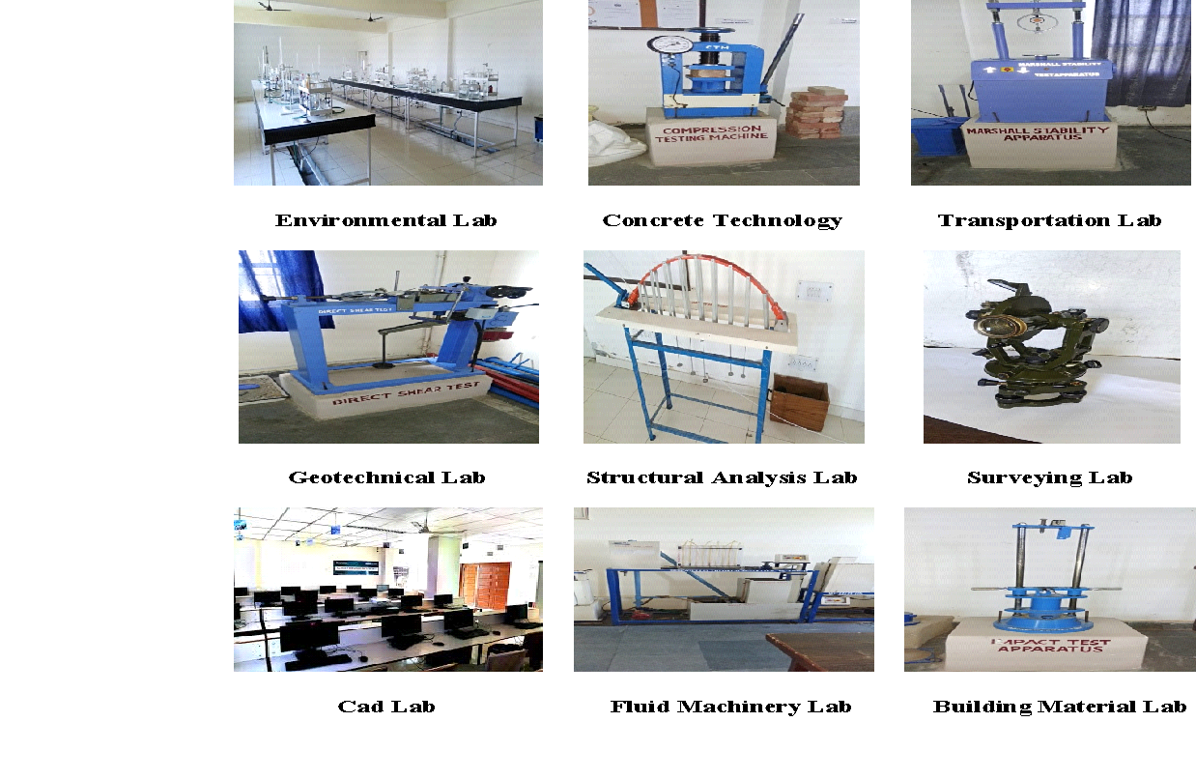
MODERN INFRASTRUCTURE

Slide 9
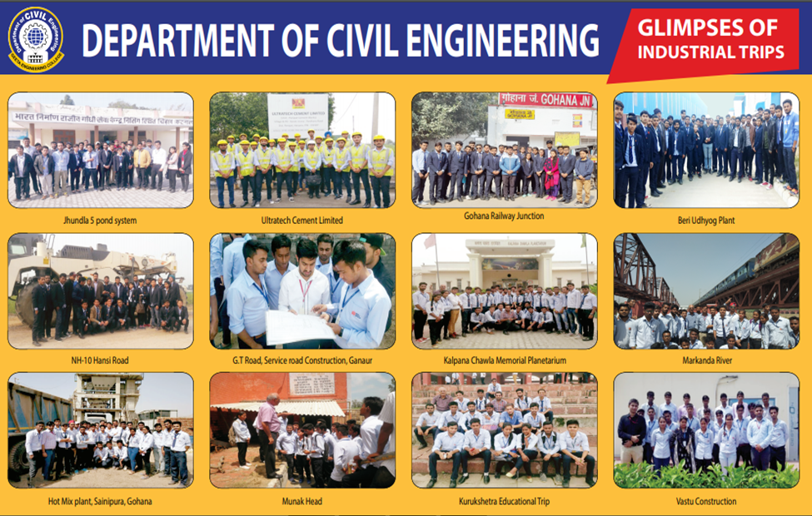

Slide 10
STUDENTS GROOMING

Slide 11
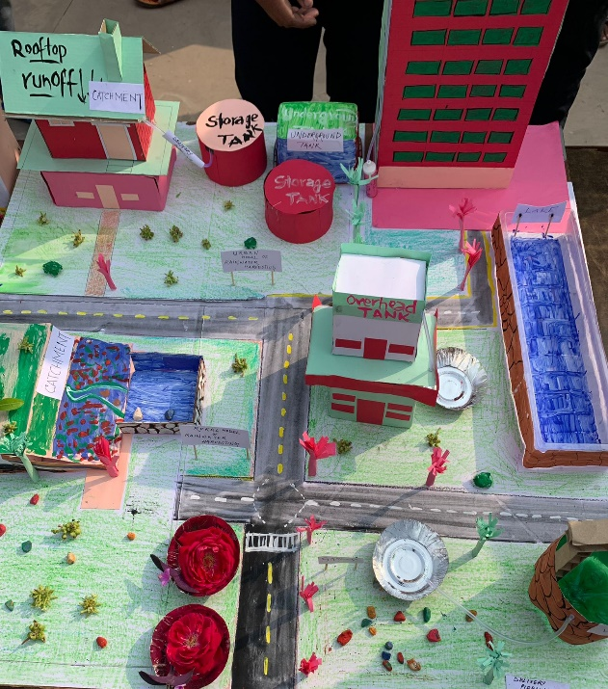
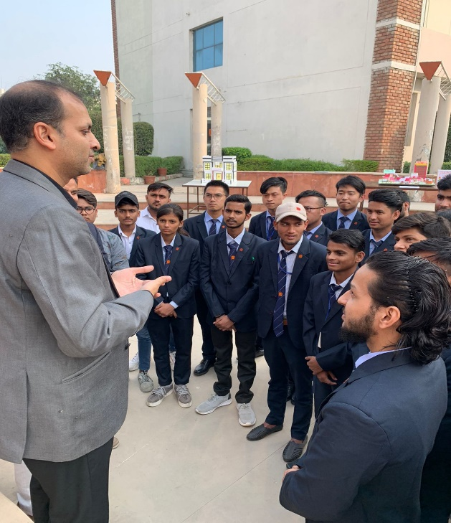

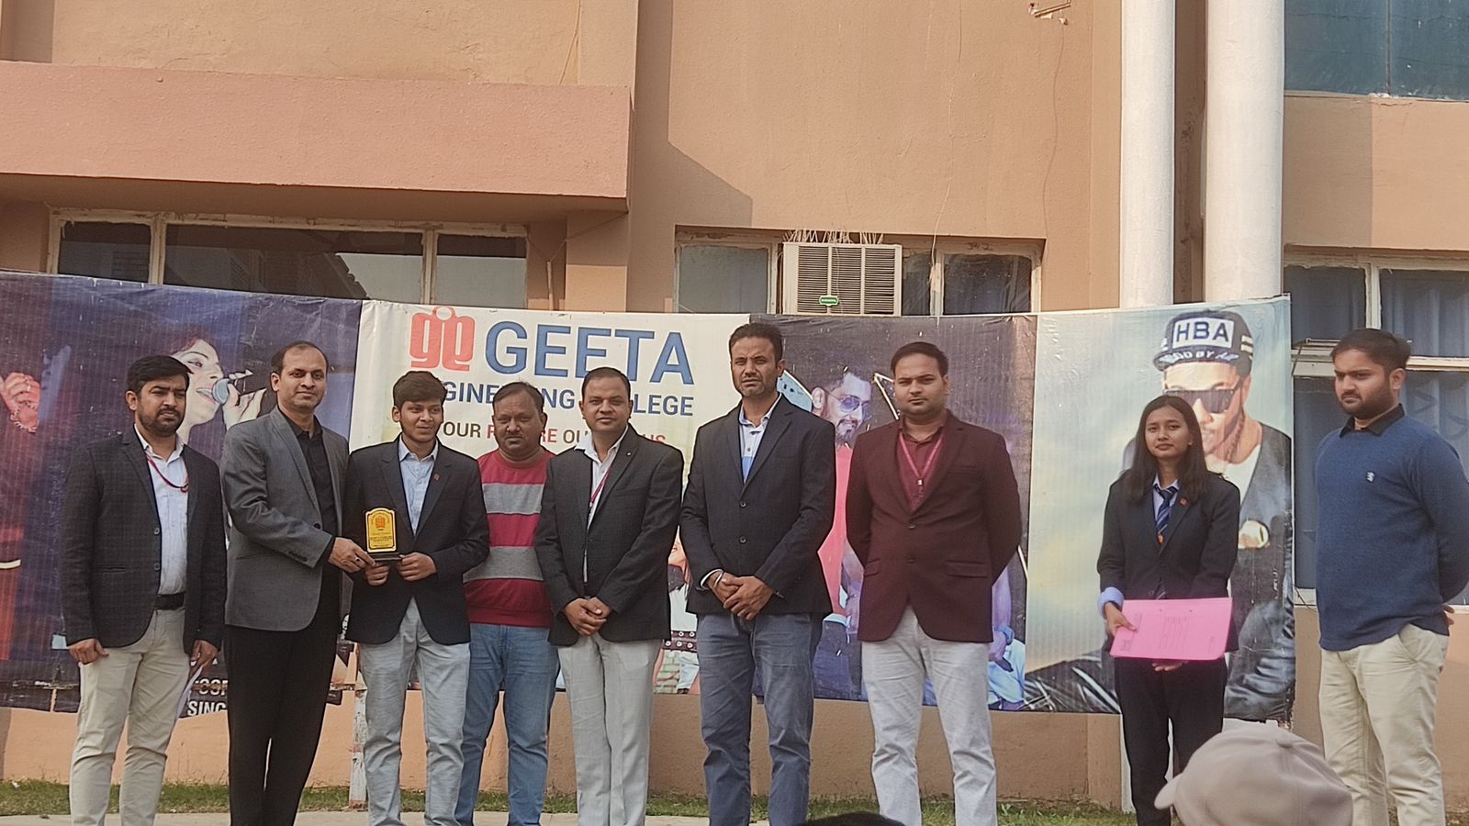
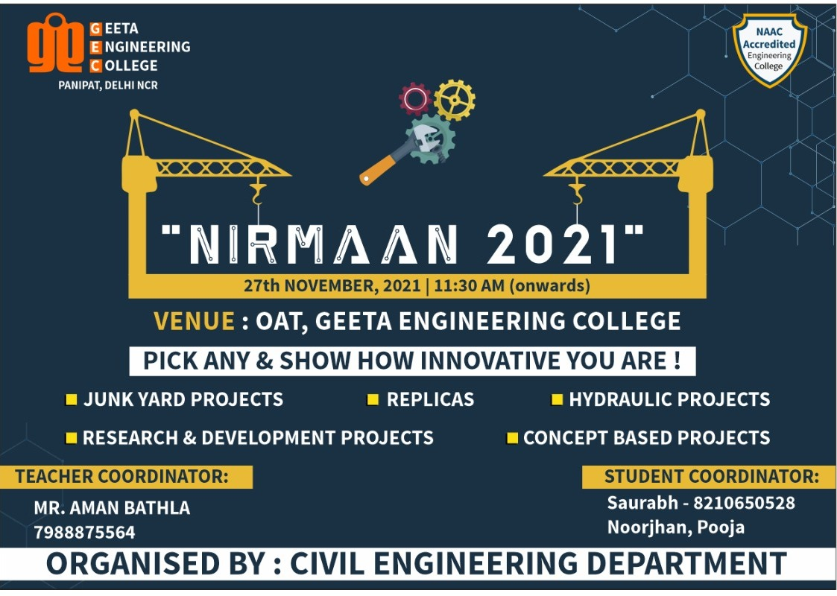
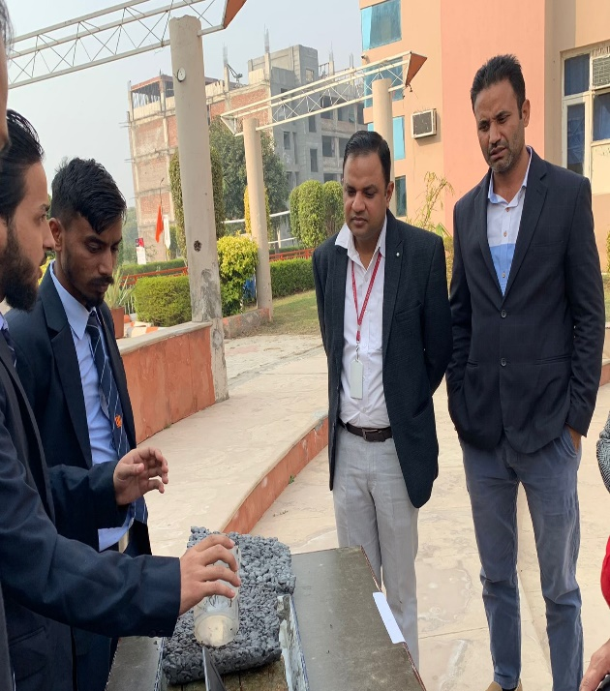
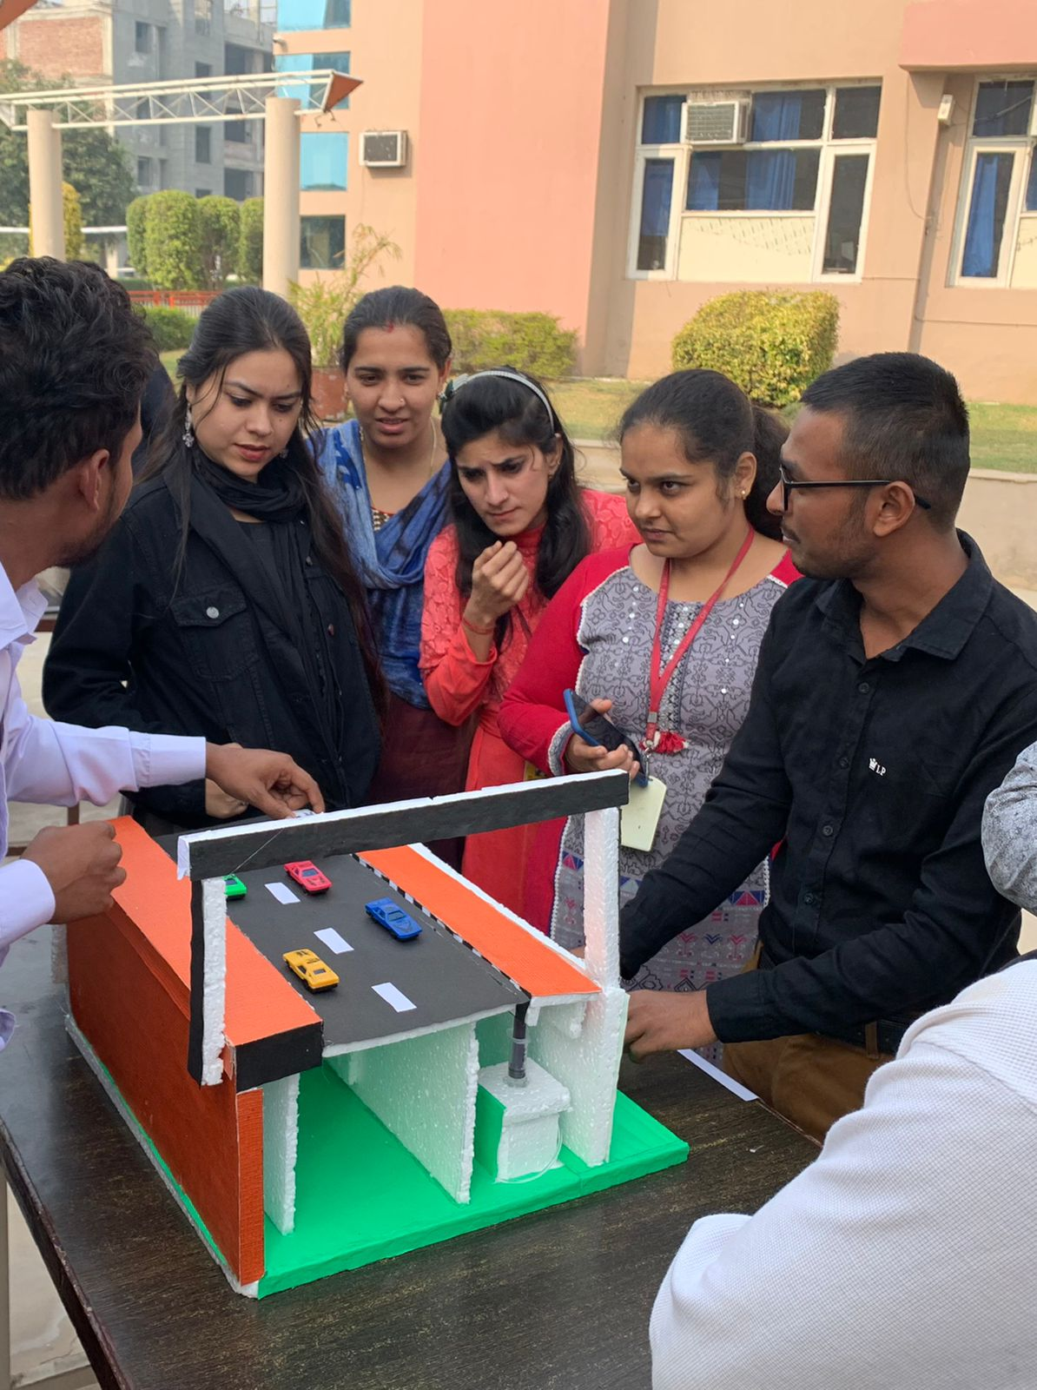
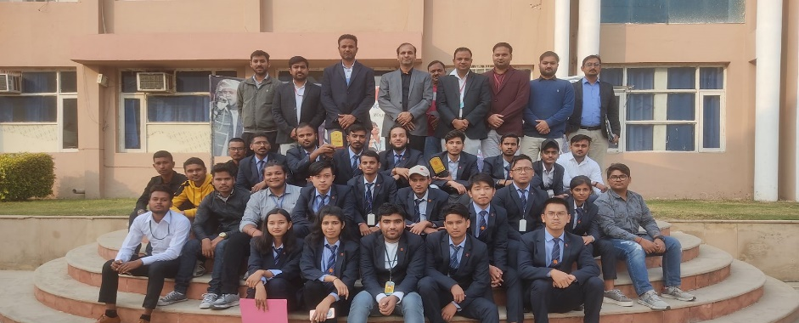
NIRMAAN 2k21
PROJECT DISPLAY COMPETITION

Slide 12
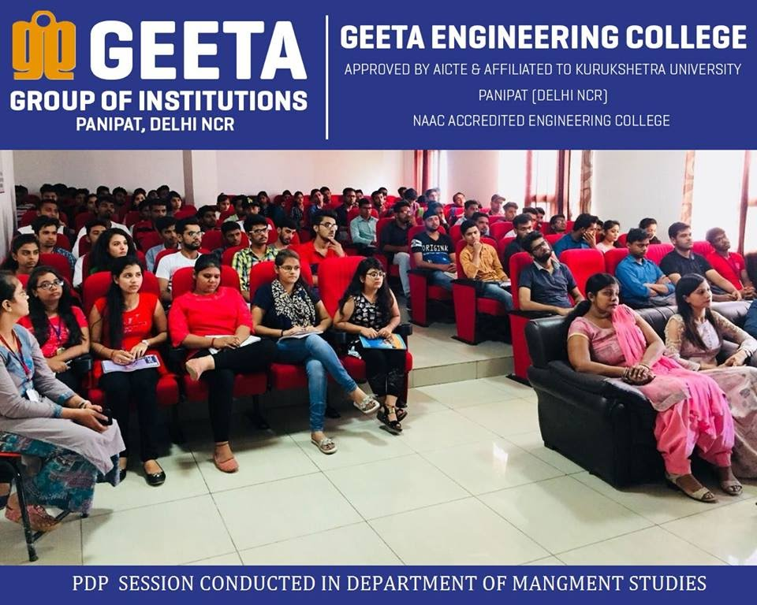
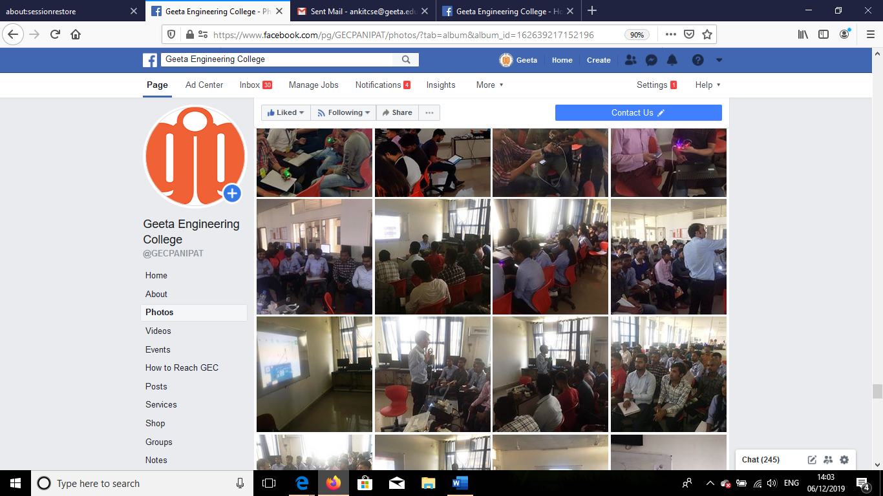
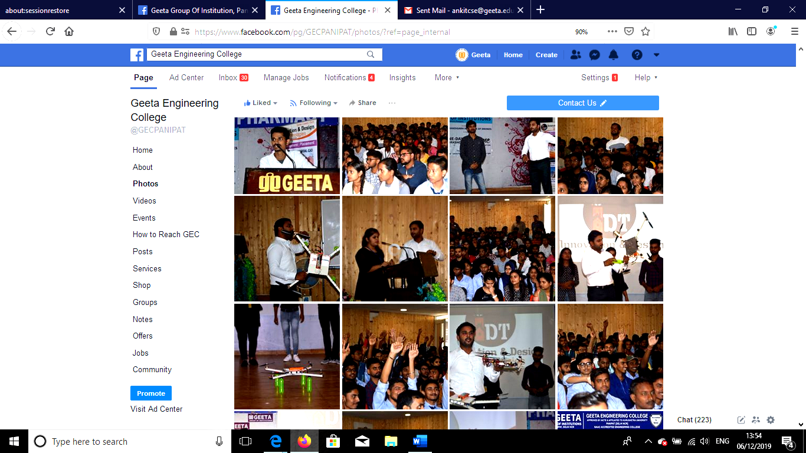
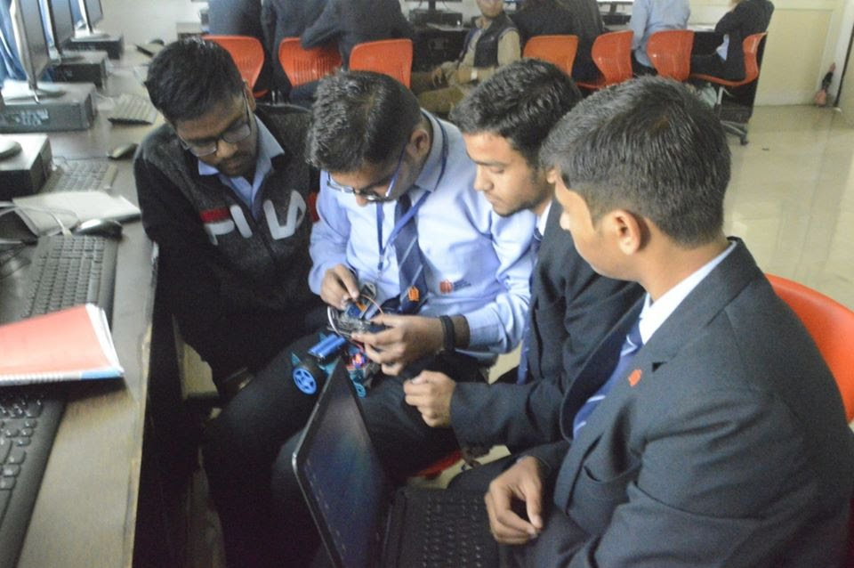
WORKSHOPS
PDP Session
Staad Pro
DRONE
AI - ROBOTICS

Slide 13
STUDENT ACHIEVEMENTS
Rahul Kimar, B. Tech. Civil Final Year get selected as Associate Recruiter in ARTECH at the package of 4.68LPA.
Saji Sangyu, students of B. Tech. Civil 2nd Year has won First prize in LOGO MAKING CONTEST for Geeta Sports Club, Geeta Engineering College.
Taru Tasser, students of B. Tech. Civil 2nd Year has won First prize in INTER-DEPARTMENT CHESS COMPETITION organised on National Mathematics Day, Geeta Engineering College.
Team of B. Tech. Civil Final Year stood First in college technical event, NIRMAAN 2K21- PROJECT MAKING COMPETITION for presenting their Project- Previous Concrete.
Team of B. Tech. Civil Final Year stood Third in INNOVATIVE IDEA CONCLAVE.
Team of B. Tech. Civil Engineering – Civil warriors reached in the semi-final match of GEETA VOLLEYBALL LEAUGUE- Intercollege Volleyball Competition.

Slide 14

MAJOR RECRUITERS

Slide 15
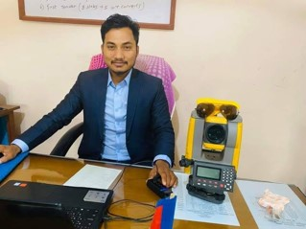
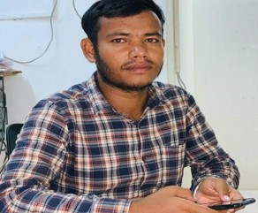
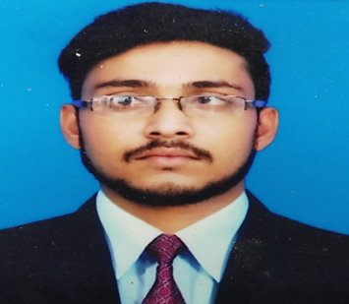
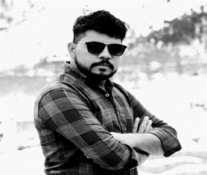
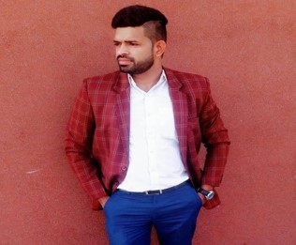

PLACED STUDENTS
Suraj Yadav
3.84LPA
Sher Bahadur
3.60LPA
Sahazada Sheikh
4.8LPA
Ravi
4.56LPA
Rakesh Saini
4.56LPA
Rahil Rana
9.60LPA

Slide 16
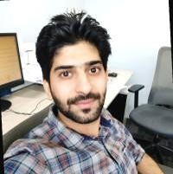
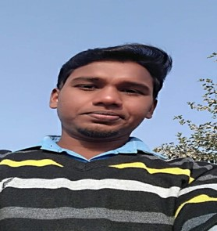
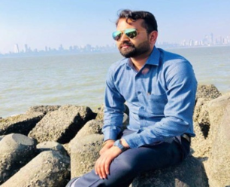
PLACED STUDENTS
.
Manjeet
3.90 LPA
Guddu Kumar
3.60LPA
Ajay Ahlawat
6.16LPA

Slide 17
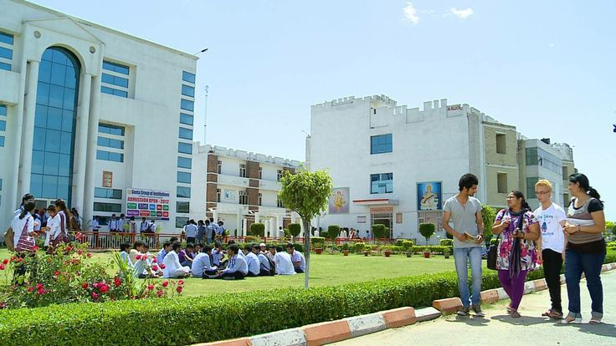
THANK YOU VIEWERS….

